Slide 1
Accelerating Systems with Programmable Logic Components Lecture 11 Neural network I
1DT109 ASPLOC
2022 VT1-VT2
Yuan Yao, yuan.yao@it.uu.se

Slide 2
Agenda
A brief introduction to neural network and deep learning
The handwritten digit recognizing problem
Perceptron
Sigmoid neurons
Neural network architecture
Learning with gradient descent

Slide 3
A brief introduction to neural networks and deep learning
Neural networks, a beautiful biologically-inspired programming paradigm which enables a computer to learn from observational data.
Deep learning, a powerful set of techniques for learning in neural networks.
Neural networks and deep learning currently provide the best solutions to many problems in:
image recognition,
speech recognition,
natural language processing,
etc.

Slide 4
A brief introduction to neural networks and deep learning
In the conventional approach to programming, we tell the computer what to do, breaking big problems up into many small, precisely defined tasks that the computer can easily perform.
In a neural network, we don't tell the computer how to solve our problem.
Instead, neural networks learn from observational data, figuring out its own solution to the problem at hand.
Although promising, we didn’t know how to train neural networks to surpass traditional approaches, until 2006.
What happens in 2006?

Slide 5
A brief introduction to neural networks and deep learning
What changed in 2006 was the discovery of techniques for learning in so-called deep neural networks.
Geoffrey E. Hinton, Simon Osindero, Yee-Whye The, “A Fast Learning Algorithm for Deep Belief Nets”, Neural Computation 18, 1527–1554, 2006. (Communicated by Yann Le Cun)
These techniques are now known as deep learning.
In coincidence with the multi-core era.
Since then, neural networks and deep learning are being developed on a large scale by companies such as Google, Microsoft, and Facebook.

Slide 6
What we will learn
Core concepts of neural networks
Modern techniques for deep learning
Expected outcome
Solid understanding of the core principles of neural networks and deep learning.
Skills to code your own neural network.
Required knowledge
Modest Math in elementary algebra, multivariable calculus.
We will go and learn the core principles through living codes.

Slide 7

Using neural networks to recognize handwritten digits
What are those pixels?
They are numbers in a sequence: 504192
How you recognize those numbers, technically speaking?
In each hemisphere of our brain, humans have a primary visual cortex, also known as V1, containing 140 million neurons, with tens of billions of connections between them.
Human vision involves not just V1, but an entire series of visual cortices - V2, V3, V4, and V5
NN and DL mimics that structure.

Slide 8
Is it possible to use neural networks to recognize handwritten digits?
However…
The difficulty of visual pattern recognition becomes apparent if we attempt to write a computer program to recognize digits like
We can do the job fast and even unconsciously.
How to make a machine achieve the same good as us?
When we try to make such rules precise, you quickly get lost in a morass of exceptions and caveats and special cases.
Hopeless.

Slide 9
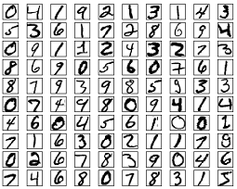
But …
We if we approach the problem in a different way.
The idea is to take a large number of handwritten digits, known as training examples.
We let the machine/program to infer information from pixels by feeding it with priori knowledge.
By increasing the number of training examples, the network can learn more about handwriting, and so improve its accuracy.

Slide 10
Yes, it is possible!
Today, banks use NN to recognize handwritten digits.
Post offices use NN to recognize addresses.
We will code a NN today to recognize handwritten digits.
And achieve 96% accuracy.
The same principle also applies to speech recognition, natural language processing, and other domains.

Slide 11
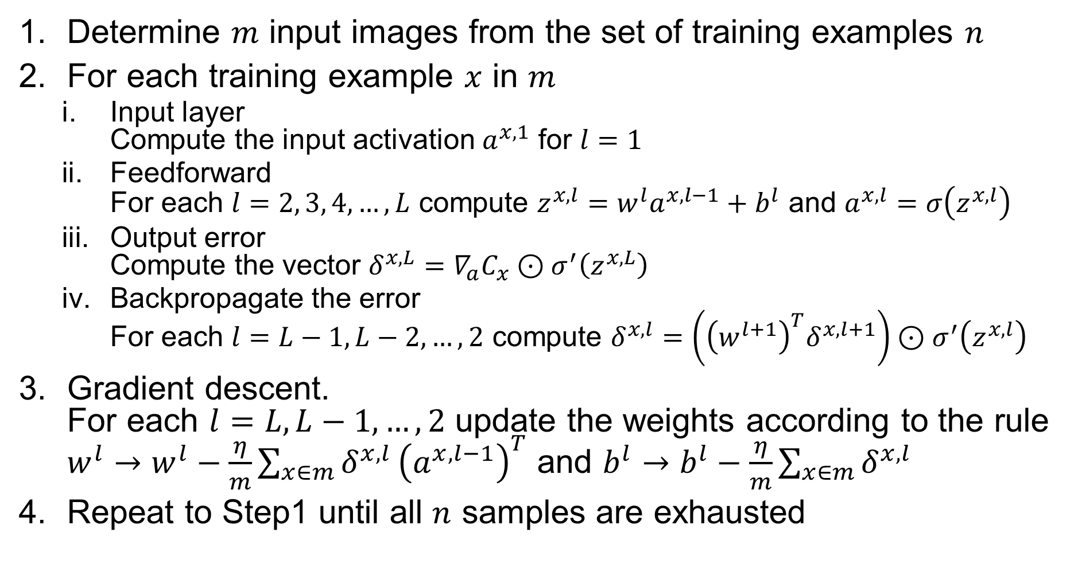
HDR-NN algorithm – the complete steps
Determine $m$ input images from the set of training examples $n$
For each training example $x$ in $m$
Input layer Compute the input activation $a^{x, 1}$ for $l=1$
Feedforward For each $l=2, 3, 4, …, L$ compute $z^{x, l}=w^{l}a^{x, l−1}+b^{l}$ and $a^{x, l}=σ\left(z^{x, l}\right)$
Output error Compute the vector $δ^{x,L}=∇_{a}C_{x}⊙σ^{′}\left(z^{x,L}\right)$
Backpropagate the error For each $l=L−1, L−2, …, 2$ compute $δ^{x,l}=\left({\left(w^{l+1}\right)}^{T}δ^{x,l+1}\right)⊙σ^{′}\left(z^{x,l}\right)$
Gradient descent. For each $l=L, L−1, …, 2$ update the weights according to the rule $w^{l}→w^{l}−\frac{η}{m}\sum_{x∈m}{δ^{x,l}}{\left(a^{x, l−1}\right)}^{T}$ and $b^{l}→b^{l}−\frac{η}{m}\sum_{x∈m}{δ^{x,l}}$
Repeat to Step1 until all $n$ samples are exhausted

Slide 12
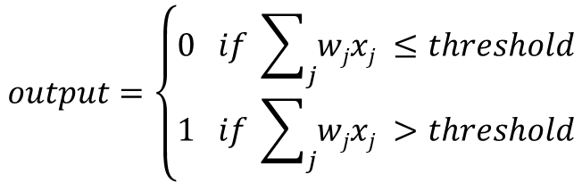
Perceptrons
To get started, we will learn a type of artificial neuron called a perceptron.
Perceptrons were developed in the 1950s and 1960s by the scientist Frank Rosenblatt, inspired by earlier work by Warren McCulloch and Walter Pitts.
A perceptron takes several binary inputs, x₁, x₂,…, each associated with a weight w₁, w₂, ...
A perceptron produces a single binary output.
$$output=\left\{\begin{aligned}0 if \sum_{j}{wjxj ≤threshold} \\ 1 if \sum_{j}{wjxj >threshold}\end{aligned}\right.$$

Slide 13
Perceptrons
Perceptron is a device that makes decisions by weighing up evidence.
Suppose that you want (and you should) to eat something after this very lecture.
Is the weather good?
Is the food good?
Do your friends want to go with you?
We can represent these three factors by corresponding binary variables x₁, x₂, x₃.
We can give weight to each factor such as w₁=6 for the weather, and w₂=2, w₃=2 for the other conditions.

Slide 14
Perceptrons
We can tune weight/threshold to manipulate the decision-making model of a Perceptron
We can choose a threshold of 5 for the perceptron.
The perceptron is weather dominated
Weather = 1 → we should go
Weather = 0 → we should not go
We can choose a different weight for weather.
The perceptron is not weather dominated
Weather = 1 → food/friends
Weather = 0 → we should not go

Slide 15
Perceptrons
Each perceptron has a single output. However, we use multiple lines to show how its output is reusing by the next level of perceptrons.
In the previous example, how you can tell if weather is good, food is good, and friends want to go?
The single perceptron model isn't a complete model of human decision-making.
But a complex network of perceptrons could make quite subtle decisions.
In the example right, each factor is determined further by another layer of perceptrons, and so on.
Each layer has its own weights and threshold to make a “solid” decision for the next layer.

Slide 16
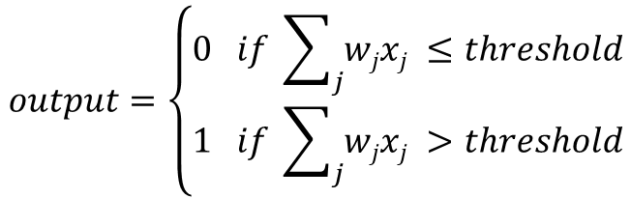

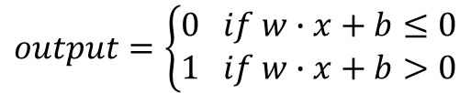
Perceptrons
When the NN grows to a large number of perceptrons, we need a simplified way to describe perceptrons.
The formula: $if \sum_{j}{wjxj ≤threshold}$ is cumbersome.
We will do two things:
The first change is to write $\sum_{j}{wjxj}$ as a dot product, $w∙x$, where $w$ and $x$ are vectors, whose components are the weights and inputs, respectively.
The second change is to move the threshold to the other side of the inequality, and to replace it by what's known as the perceptron's bias, $b=−threshold$.
Bias models how easily a perceptron fires:
Big bias → easy to fire (output 1).
Small bias → hard to fire (output 0).
N.B.
b = - threshold
$$output=\left\{\begin{aligned}0 if \sum_{j}{wjxj ≤threshold} \\ 1 if \sum_{j}{wjxj >threshold}\end{aligned}\right.$$
$$output=\left\{\begin{aligned}0 if w∙x+b≤0 \\ 1 if w∙x+b>0\end{aligned}\right.$$

Slide 17
Perceptrons
Why perceptron, or a network of perceptrons, is efficient in making complicated decision (in implementing complicated logic functions).
What does the following perceptron implement?
x1 | x2 | Evaluation | Output
0 | 0 | 0*(-2) + 0*(-2) + 3 > 0 | 1
0 | 1 | 0*(-2) + 1*(-2) + 3 > 0 | 1
1 | 0 | 1*(-2) + 0*(-2) + 3 > 0 | 1
1 | 1 | 1*(-2) + 1*(-2) + 3 < 0 | 0
A NAND gate!
Because NAND gates are universal for computation, it follows that perceptrons are also universal for computation.

Slide 18
Perceptrons
How to make the NN self-tune the weights/bias to implement different functions?
By tuning weights and bias, perceptrons can implement different logic gates. Thus, a perceptron net can implement complicated logic functions.

Slide 19
A desired property of NN
Suppose we have a network of perceptrons that we'd like to use to learn to solve some problem.
For example, the inputs to the network might be the raw pixel data from a scanned, handwritten image of a digit. And we'd like the network to learn weights and biases so that the output from the network correctly classifies the digit.
The network should have the following property.

Slide 20
A desired property of NN
If an NN has this desired property, then the NN would be learning in the following 3 steps.
Suppose the network was mistakenly classifying an image as an “8” when it should be a “9”.
We could figure out how to make a small change in the weights and biases, so the network gets a little closer to classifying the image as a “9”.
And then we'd repeat this, changing the weights and biases over and over to produce better and better output.

Slide 21
Sigmoid neuron
Perceptron-based NN is hard to achieve this property since perceptron fires either “0” or “1” (total flip).
The consequence is that while you can tune your NN to correctly recognize “9” now, it may not correctly recognize digits that it recognizes before.
The NN becomes “oscillated”.
We need a new kind of perceptron that can be fine-tuned.
Sigmoid neuron.

Slide 22
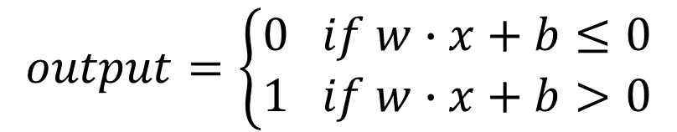
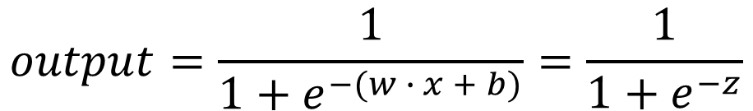
Sigmoid neuron
Sigmoid neurons are like perceptrons.
But, small changes in sigmoid neuron’s weights and bias cause only a small change in their output.
“Discrete” → “Contiguous”
Sigmoid neuron also has inputs and weights
Input to sigmoid neuron ranges contiguously in [0, 1]
Sigmoid neuron also has one output
Output ranges contiguously in [0, 1], too
$$output=\left\{\begin{aligned}0 if w∙x+b≤0 \\ 1 if w∙x+b>0\end{aligned}\right.$$
$$output=\frac{1}{1+e^{−(w ∙ x + b)}}=\frac{1}{1+e^{−z}}$$

Slide 23
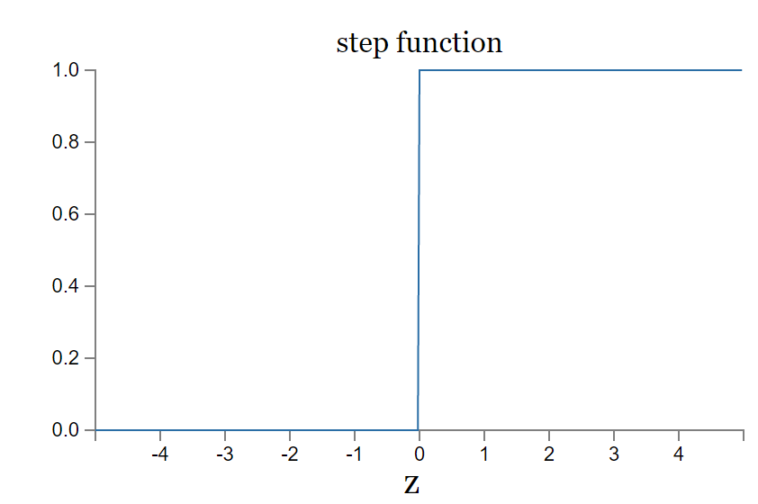
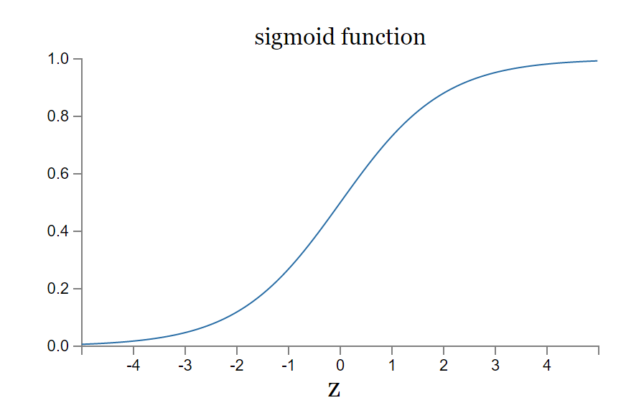
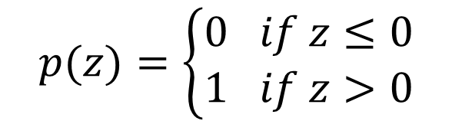
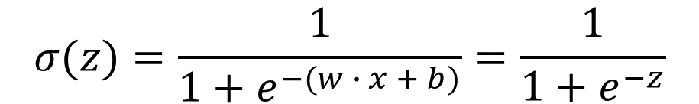
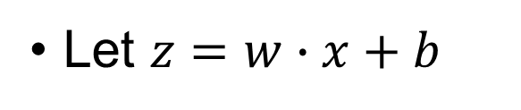
Perceptron vs Sigmoid neuron
Let $z=w∙x+b$
$$p(z)=\left\{\begin{aligned}0 if z≤0 \\ 1 if z>0\end{aligned}\right.$$
$$σ(z)=\frac{1}{1+e^{−(w ∙ x + b)}}=\frac{1}{1+e^{−z}}$$
Sigmoid neuron is a smoothed-out perceptron.
The smoothness of σ is the key.

Slide 24
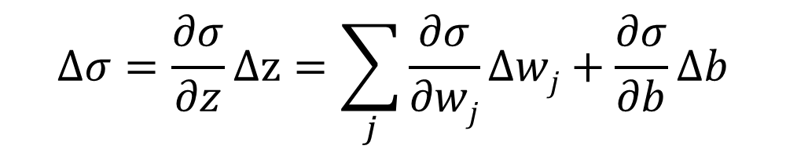






Sigmoid neuron
$$σ(z)=\frac{1}{1+e^{−(w ∙ x + b)}}=\frac{1}{1+e^{−z}}$$
We can amend the output of sigmoid neuron (decision) by fine-tuning the weight and bias.
$σ(z+Δz)$
$$σ′(z)$$
$$Δσ$$
$$σ\left(z\right)$$
$$Δz$$
$$Δσ=\frac{∂σ}{∂z}Δz=\sum_{j}{\frac{∂σ}{∂wj}}Δwj+\frac{∂σ}{∂b}Δb$$
$σ(z+Δz)=$ $σ\left(z\right)+σ′(z)∙Δz$
$$σ\left(z+Δz\right)−σ\left(z\right)=σ^{′}\left(z\right)∙Δz$$

Slide 25
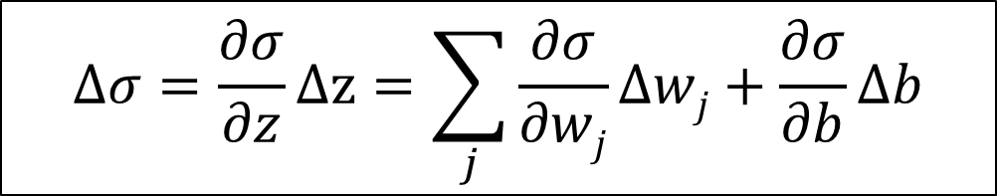
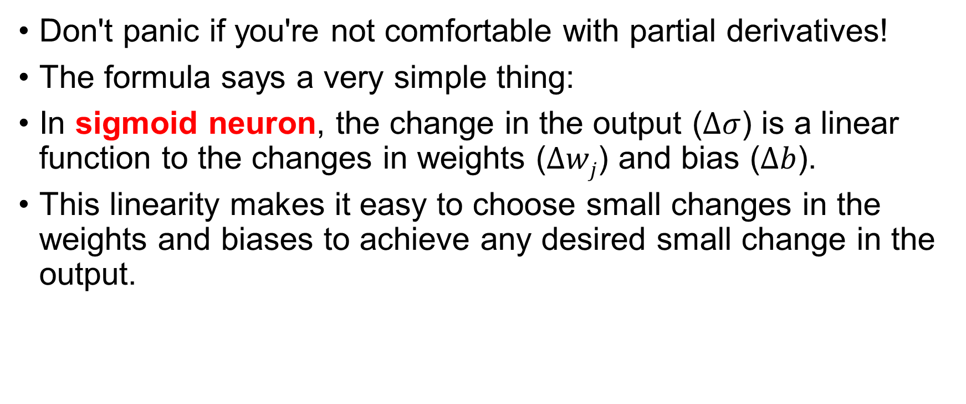
Sigmoid neuron
Don't panic if you're not comfortable with partial derivatives!
The formula says a very simple thing:
In sigmoid neuron, the change in the output ($Δσ$) is a linear function to the changes in weights ($Δwj$) and bias ($Δb$).
This linearity makes it easy to choose small changes in the weights and biases to achieve any desired small change in the output.
$$Δσ=\frac{∂σ}{∂z}Δz=\sum_{j}{\frac{∂σ}{∂wj}}Δwj+\frac{∂σ}{∂b}Δb$$

Slide 26
Sigmoid neuron
Sigmoid neuron outputs in range [0, 1]
This gives us a notion of “belief” in the final decision.
If Weather is bad (0), but the food is good (1) and your friends want to go (1)
Perceptron outputs 0.
No, don’t go.
Sigmoid outputs 0.26.
Well, generally speaking, don’t go.
But you still have a reason to go.

Slide 27
Exercise 1
Suppose we take all the weights and biases in a network of perceptrons, and multiply them by a positive constant, C>0. Show that the behavior of the network change or not?
How about apply the constant C>0 to a sigmoid neuron based NN?

Slide 28
Neural network architecture
Input layer
Output layer
Hidden layer
Hidden = not an input or an output layer
Also called as multilayer perceptrons or MLPs
Confusing
For a handwritten digit recognizing NN
Input layer has 64*64 input neurons (suppose 64*64 image)
Output layer has 10 output neurons (one for each digit)

Slide 29
Neural network architecture
While the design of the input and output layers of a neural network is often straightforward, there can be quite an art to the design of the hidden layers.
How many layers?
How many neurons each layer?
What are the weights and biases?
Should we have loops (accept output from later layer neurons)?
Recurrent neural network does accept loops.
We will use feedforward NN in our lecture
The art of an efficient NN hides in the designing of the hidden layers.

Slide 30
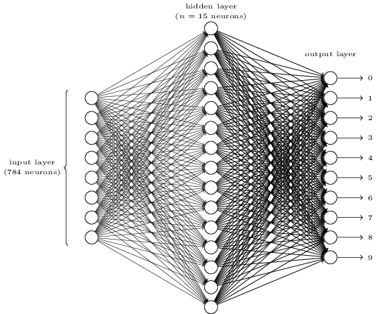
Handwritten digit recognizing neural network (HDR-NN) – architecture
Simple three-layer network
Input layer 28*28=784 neurons.
Output layer 10 neurons.
1 for representing each digit
Neuron with the highest output wins
1 hidden layer with 15 neurons.
11910 edges, each with a weight w_{i}.
25 sigmoid neurons, each with a bias b_{j}.

Slide 31
A heuristic-based design approach
Another way to design the output layer: 4 neurons instead of 10.
0000→digit 0, 0001→digit 1, …, 1010→digit 10.
Will this be better than using 10 neurons?
No.
Empirical explanation: because each neuron in the output layer will fire on multiple digits.
E.g, the neuron represents LSB will fire on 1,3,5,7,9
This will encourage each neuron in the output layer make ambiguous decision instead of binary decision.
However, finding a formal proof for why this is bad is very hard.
With all that said, this is all just a heuristic.

Slide 32
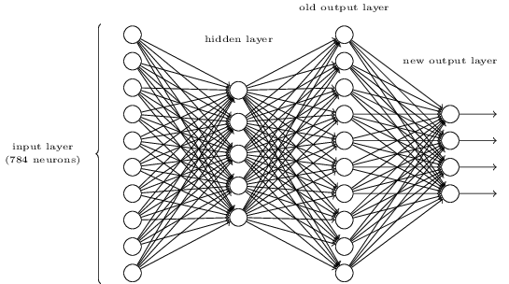
Exercise 2
There is a way of determining the bitwise representation of a digit by adding an extra layer to the three-layer network above.
The extra layer converts the output from the previous layer into a binary representation, as illustrated in the figure below.
Find a set of weights and biases for the new output layer.
Assume that the first 3 layers of neurons are such that the correct output in the third layer (i.e., the old output layer) has activation at least 0.99, and incorrect outputs have activation less than 0.01.

Slide 33

Train a neural network
Now that we have a design for our neural network, how can it learn to recognize digits?
We need two things
A training set with real-world handwritten digits samples
MNIST data set, tens of thousands (60,000 for training and 10,000 for test) of scanned images of handwritten digits (from 250 people, in 28*28-pixel format), together with their correct classifications.
The following is a few pictures from MINIST
A way to train the neural network
Gradient descent.
Y. LeCun, L. Bottou, Y. Bengio, and P. Haffner. "Gradient-based learning applied to document recognition." Proceedings of the IEEE, 86(11):2278-2324, November 1998.

Slide 34
HDR-NN – Input/Output
We'll use the notation x to denote a training input.
Each x represents a 28×28=784-dimensional vector.
Each entry (x_{i}) in the vector represents the grey value for a single pixel in the image.
We'll denote the corresponding ideal output by y=y(x), where y is a 10-dimensional vector.
If a particular training image, x, depicts a digit “6”, then y(x)=(0,0,0,0,0,0,1,0,0,0)^{T}. (all sharp “1”s and “0”s)
Given the HDR-NN architecture and input/output, we would like a method to find weights and biases so that we get a result as close to y(x) for all input x as possible.

Slide 35
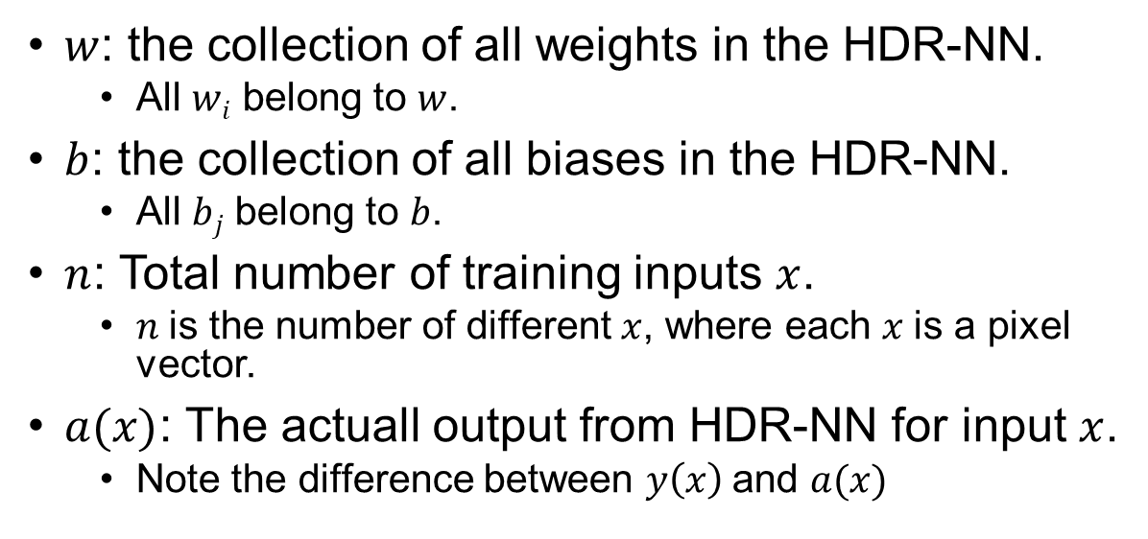
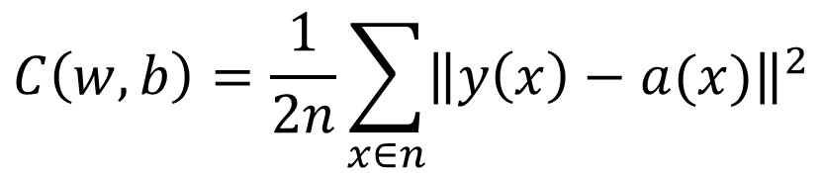
HDR-NN – the cost function
To quantify how well we're achieving this goal we define a cost function
$$C\left(w, b\right)=\frac{1}{2n}\sum_{x∈n}{{\left\|y\left(x\right)−a(x)\right\|}^{2}}$$
$w$: the collection of all weights in the HDR-NN.
All $wi$ belong to $w$.
$b$: the collection of all biases in the HDR-NN.
All $bj$ belong to $b$.
$n$: Total number of training inputs $x$.
$n$is the number of different $x$, where each $x$is a pixel vector.
$a(x)$: The actuall output from HDR-NN for input $x$.
Note the difference between $y\left(x\right)$ and $a(x)$

Slide 36
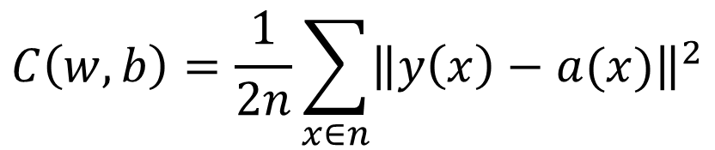
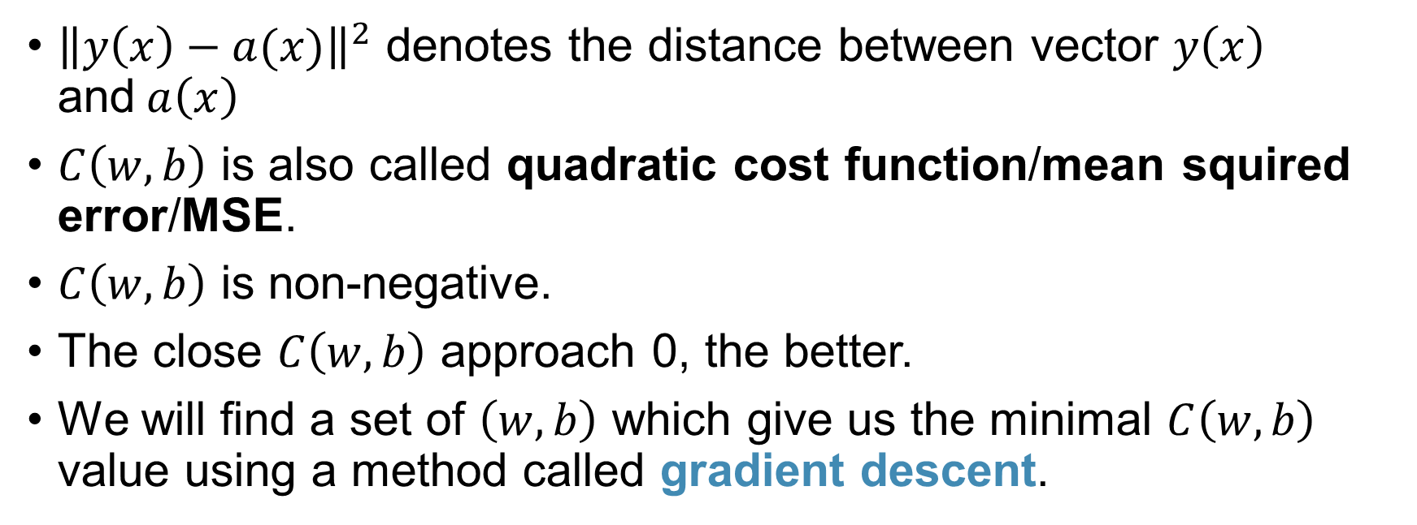
HDR-NN – the cost function
${\left\|y\left(x\right)−a(x)\right\|}^{2}$ denotes the distance between vector $y\left(x\right)$ and$a\left(x\right)$
$C\left(w, b\right)$ is also called quadratic cost function/mean squired error/MSE.
$C\left(w, b\right)$ is non-negative.
The close $C\left(w, b\right)$ approach 0, the better.
We will find a set of $\left(w, b\right)$ which give us the minimal $C\left(w, b\right)$ value using a method called gradient descent.
$$C\left(w, b\right)=\frac{1}{2n}\sum_{x∈n}{{\left\|y\left(x\right)−a(x)\right\|}^{2}}$$

Slide 37
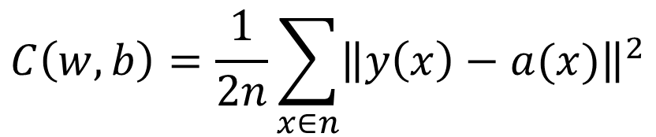
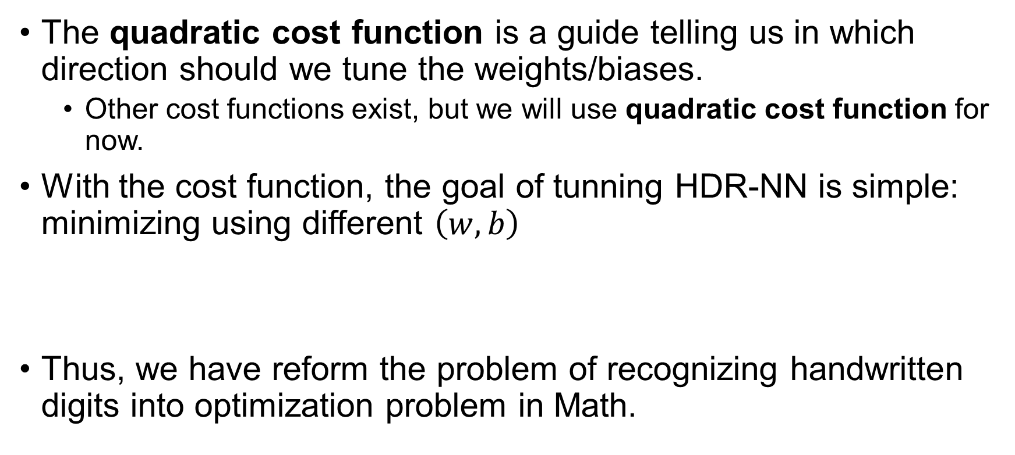
HDR-NN – the cost function
The quadratic cost function is a guide telling us in which direction should we tune the weights/biases.
Other cost functions exist, but we will use quadratic cost function for now.
With the cost function, the goal of tunning HDR-NN is simple: minimizing using different $\left(w, b\right)$
Thus, we have reform the problem of recognizing handwritten digits into optimization problem in Math.
$$C\left(w, b\right)=\frac{1}{2n}\sum_{x∈n}{{\left\|y\left(x\right)−a(x)\right\|}^{2}}$$

Slide 38
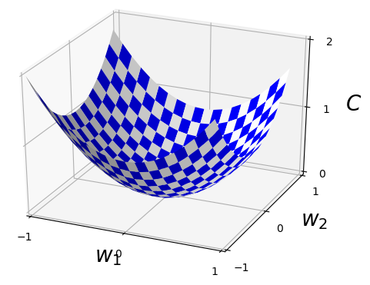
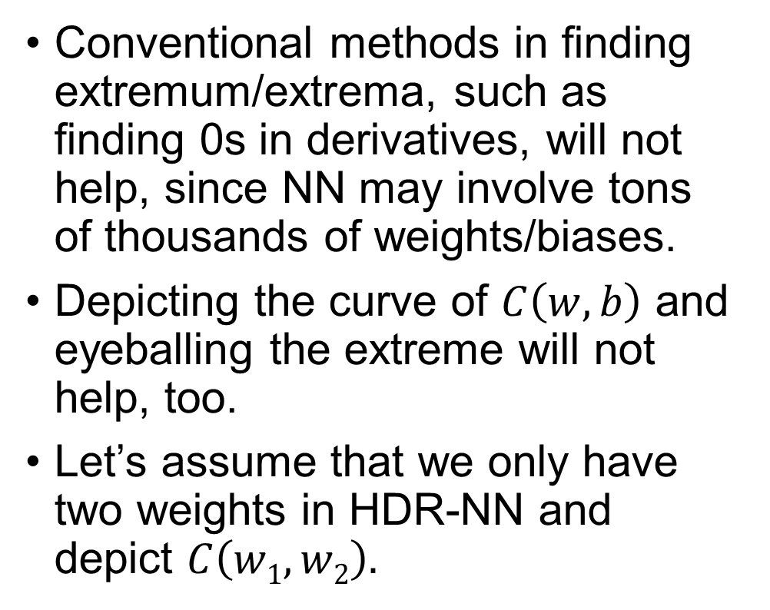
Minimizing the cost function
Conventional methods in finding extremum/extrema, such as finding 0s in derivatives, will not help, since NN may involve tons of thousands of weights/biases.
Depicting the curve of $C\left(w, b\right)$ and eyeballing the extreme will not help, too.
Let’s assume that we only have two weights in HDR-NN and depict $C\left(w1, w2\right).$

Slide 39
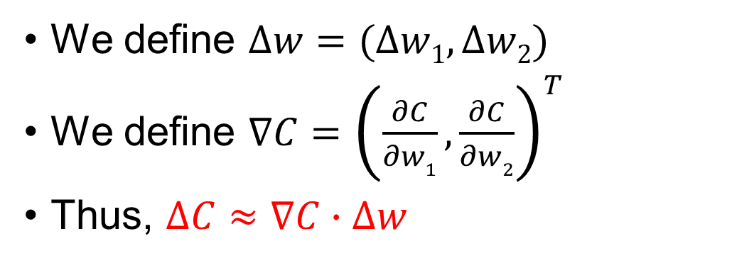
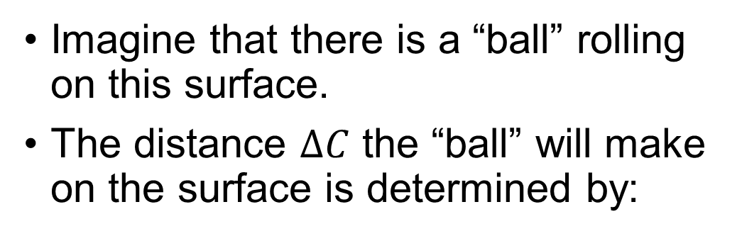


Minimizing the cost function
Imagine that there is a “ball” rolling on this surface.
The distance $∆C$ the “ball” will make on the surface is determined by:
$$∆C≈\frac{∂C}{∂w1}∆w1+\frac{∂C}{∂w2}∆w2$$
We define $∆w=(∆w1,∆w2)$
We define $∇C={\left(\frac{∂C}{∂w1},\frac{∂C}{∂w2}\right)}^{T}$
Thus, $∆C≈∇C∙∆w$

Slide 40
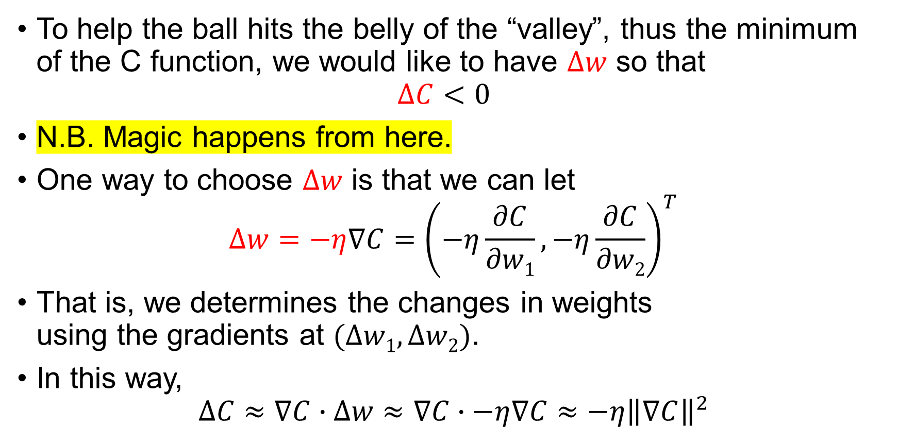


Minimizing the cost function
To help the ball hits the belly of the “valley”, thus the minimum of the C function, we would like to have $∆w$ so that $∆C<0$
N.B. Magic happens from here.
One way to choose $∆w$ is that we can let $∆w=−η∇C={\left(−η\frac{∂C}{∂w1},−η\frac{∂C}{∂w2}\right)}^{T}$
That is, we determines the changes in weights using the gradients at $(∆w1,∆w2)$.
In this way,
$$∆C≈∇C∙∆w≈∇C∙−η∇C≈−η{\left\|∇C\right\|}^{2}$$
$∆C≈−η{\left\|∇C\right\|}^{2}$ is guaranteed to be ≤ 0.
We are guaranteed to move towards the minima!
We don’t need to computer second partial derivatives in gradient descent.

Slide 41
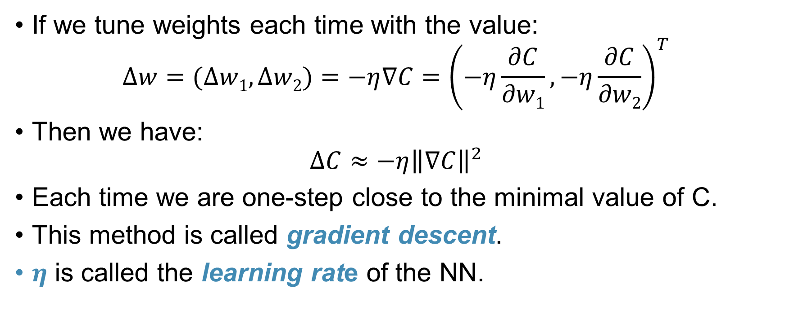

Summarizing it up
If we tune weights each time with the value: $∆w=(∆w1,∆w2)=−η∇C={\left(−η\frac{∂C}{∂w1},−η\frac{∂C}{∂w2}\right)}^{T}$
Then we have: $∆C≈−η{\left\|∇C\right\|}^{2}$
Each time we are one-step close to the minimal value of C.
This method is called gradient descent.
$η$ is called the learning rate of the NN.

Slide 42
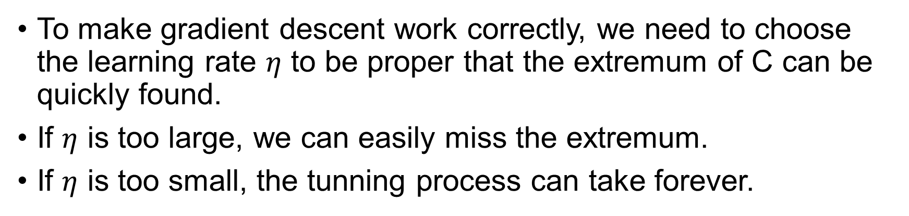

Choosing the proper learning rate
To make gradient descent work correctly, we need to choose the learning rate $η$ to be proper that the extremum of C can be quickly found.
If $η$ is too large, we can easily miss the extremum.
If $η$ is too small, the tunning process can take forever.

Slide 43
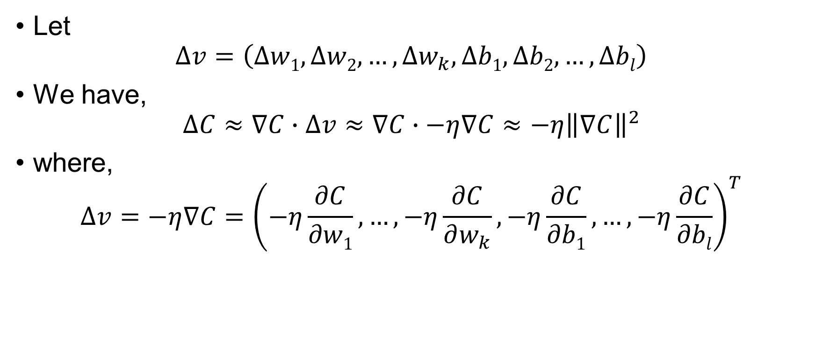
Generalizing the gradient descent method
Let $∆v=\left(∆w1,∆w2,…,∆w_{k},∆b1,∆b2,…,∆bl\right)$
We have, $∆C≈∇C∙∆v≈∇C∙−η∇C≈−η{\left\|∇C\right\|}^{2}$
where, $∆v=−η∇C={\left(−η\frac{∂C}{∂w1},…,−η\frac{∂C}{∂w_{k}},−η\frac{∂C}{∂b1},…,−η\frac{∂C}{∂bl}\right)}^{T}$

Slide 44
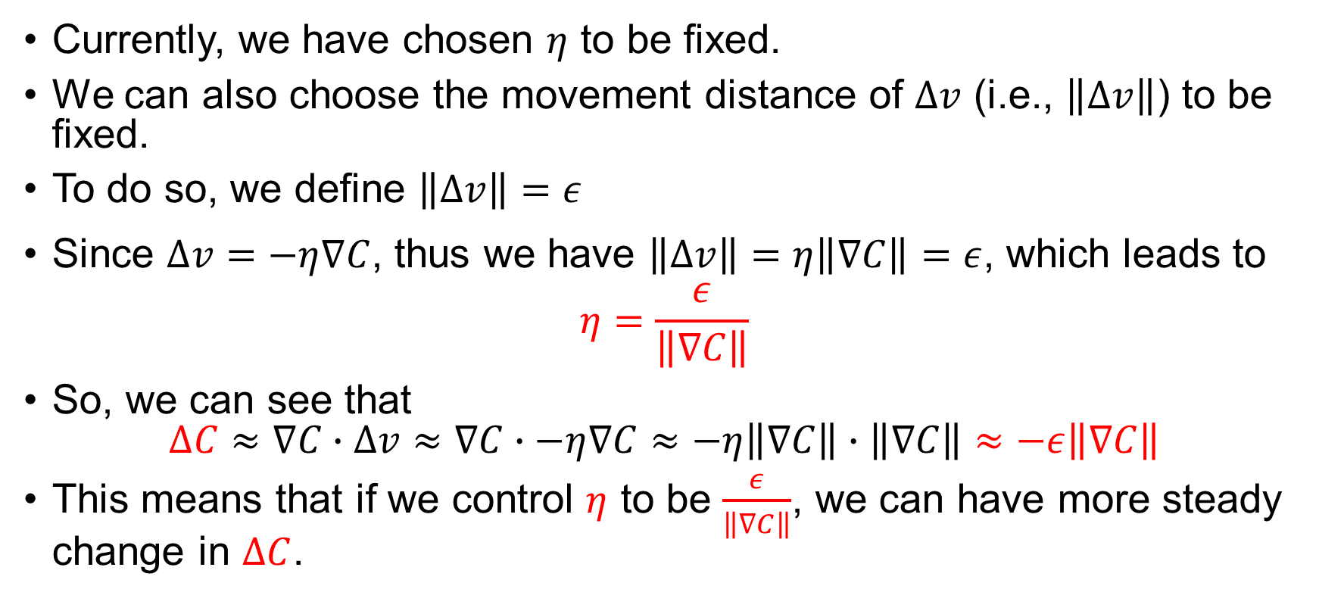
Generalizing the gradient descent method
Currently, we have chosen $η$ to be fixed.
We can also choose the movement distance of $∆v$ (i.e., $\left\|∆v\right\|$) to be fixed.
To do so, we define $\left\|∆v\right\|=ε$
Since $∆v=−η∇C$, thus we have $\left\|∆v\right\|=η\left\|∇C\right\|=ε$, which leads to $η=\frac{ε}{\left\|∇C\right\|}$
So, we can see that $∆C≈∇C∙∆v≈∇C∙−η∇C≈−η\left\|∇C\right\|∙\left\|∇C\right\|≈−ε\left\|∇C\right\|$
This means that if we control $η$ to be $\frac{ε}{\left\|∇C\right\|}$, we can have more steady change in $∆C$.

Slide 45

Exercise 3
Please prove that gradient descent is equivalent to geometric interpretation in the one-dimensional variable (i.e., we only have one variable $w$ in the cost function $C$) case.

Slide 46
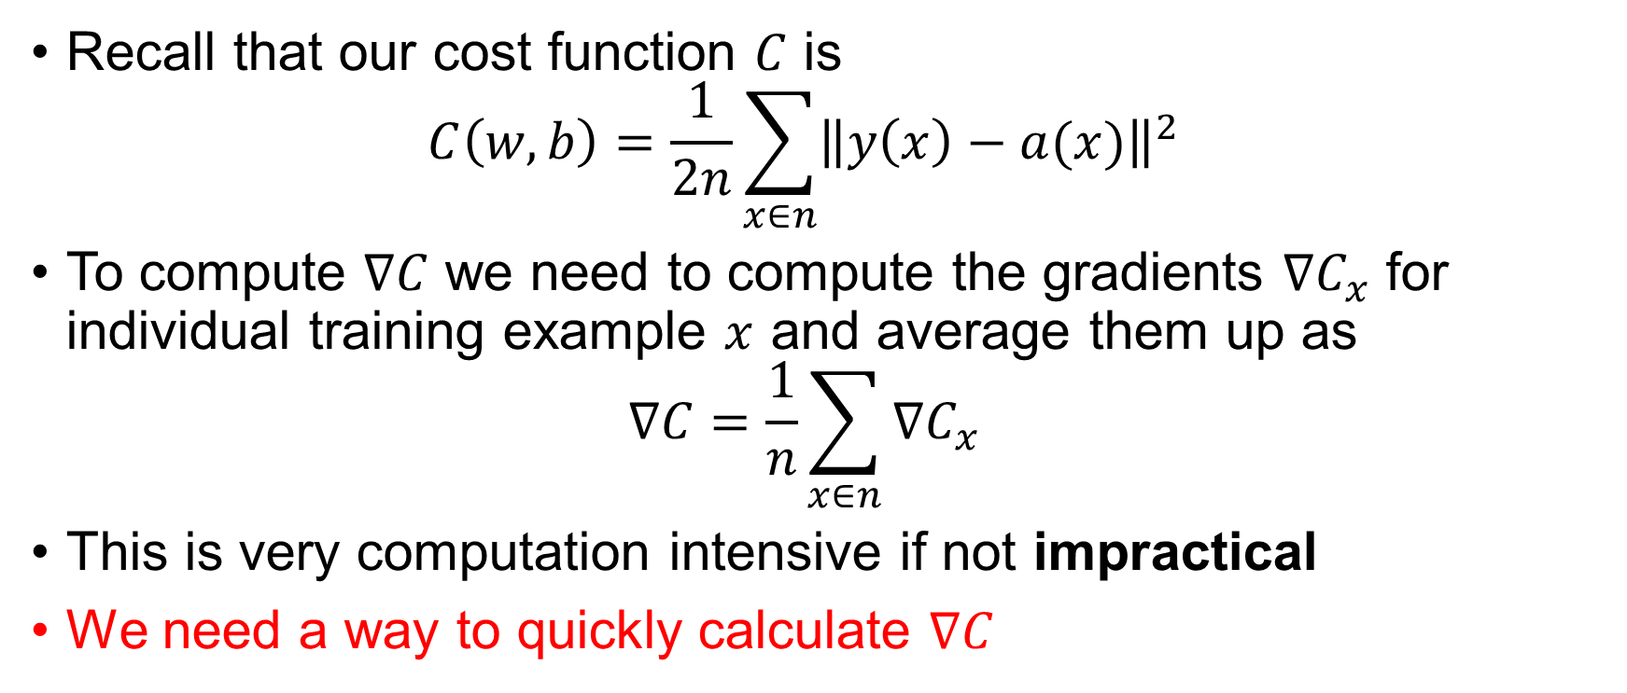
Apply gradient descent to HDR-NN
Recall that our cost function $C$ is $C\left(w, b\right)=\frac{1}{2n}\sum_{x∈n}{{\left\|y\left(x\right)−a(x)\right\|}^{2}}$
To compute $∇C$ we need to compute the gradients $∇C_{x}$ for individual training example $x$ and average them up as $∇C=\frac{1}{n}\sum_{x∈n}{∇C_{x}}$
This is very computation intensive if not impractical
We need a way to quickly calculate $∇C$

Slide 47
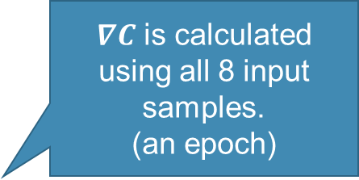
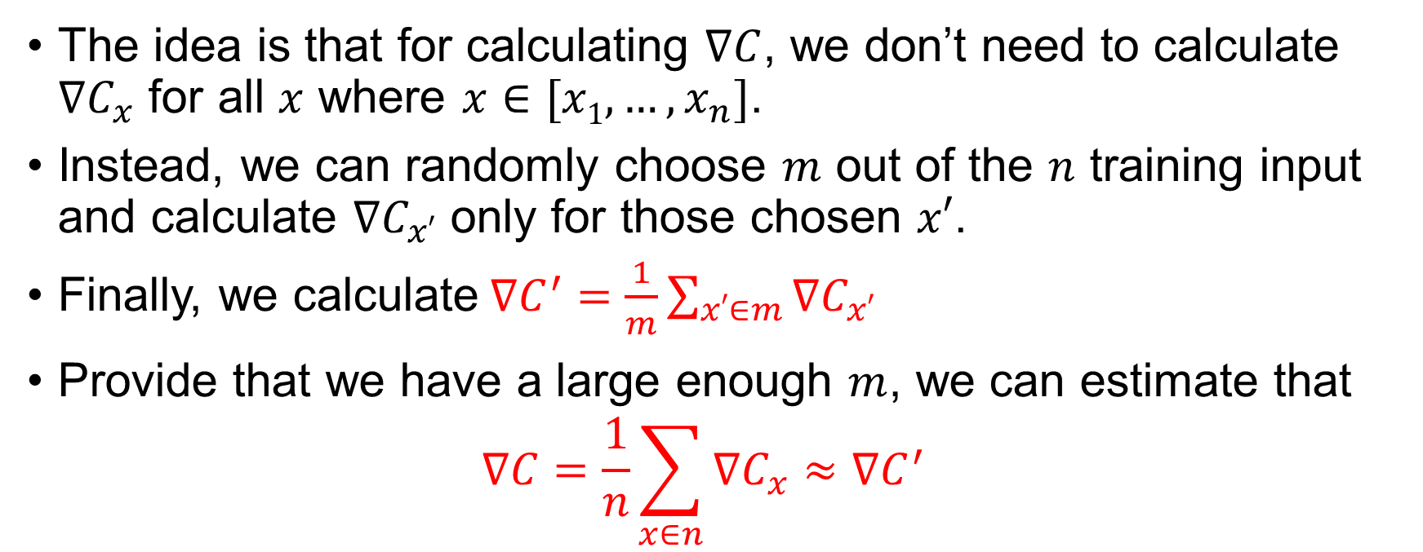
Stochastic gradient descent
The idea is that for calculating $∇C$, we don’t need to calculate $∇C_{x}$ for all $x$ where $x∈[x1,…,x_{n}]$.
Instead, we can randomly choose $m$ out of the $n$ training input and calculate $∇C_{x′}$ only for those chosen $x′$.
Finally, we calculate$∇C^{′}=\frac{1}{m}\sum_{x′∈m}{∇C_{x′}}$
Provide that we have a large enough $m$, we can estimate that $∇C=\frac{1}{n}\sum_{x∈n}{∇C_{x}}≈∇C^{′}$
All n of the input sample x is called an epoch.
$∇C$ is calculated using all 8 input samples.
(an epoch)
1
2
3
4
5
6
7
8

Slide 48
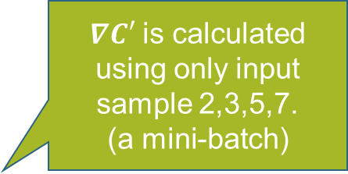
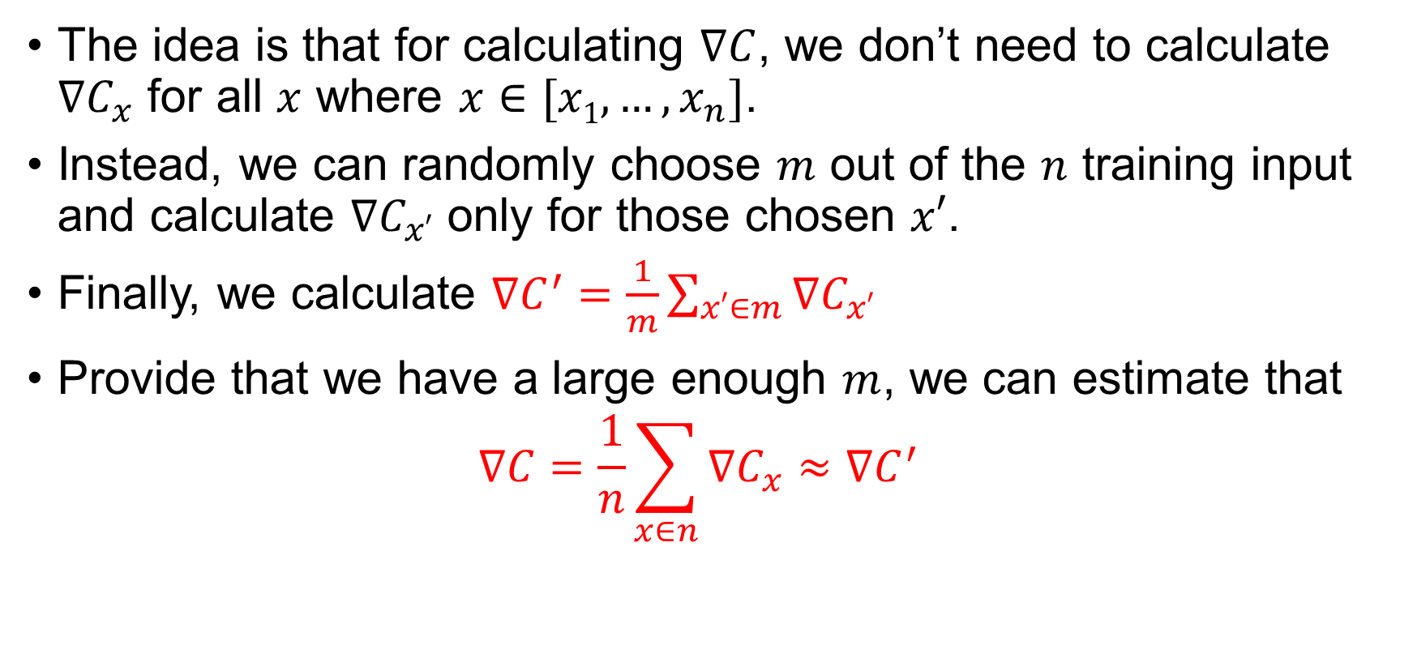
Stochastic gradient descent (SGD)
The idea is that for calculating $∇C$, we don’t need to calculate $∇C_{x}$ for all $x$ where $x∈[x1,…,x_{n}]$.
Instead, we can randomly choose $m$ out of the $n$ training input and calculate $∇C_{x′}$ only for those chosen $x′$.
Finally, we calculate $∇C^{′}=\frac{1}{m}\sum_{x′∈m}{∇C_{x′}}$
Provide that we have a large enough $m$, we can estimate that $∇C=\frac{1}{n}\sum_{x∈n}{∇C_{x}}≈∇C^{′}$
m of the input x’ from all input x is called a mini-batch.
$∇C′$ is calculated using only input sample 2,3,5,7.
(a mini-batch)
1
2
3
4
5
6
7
8

Slide 49
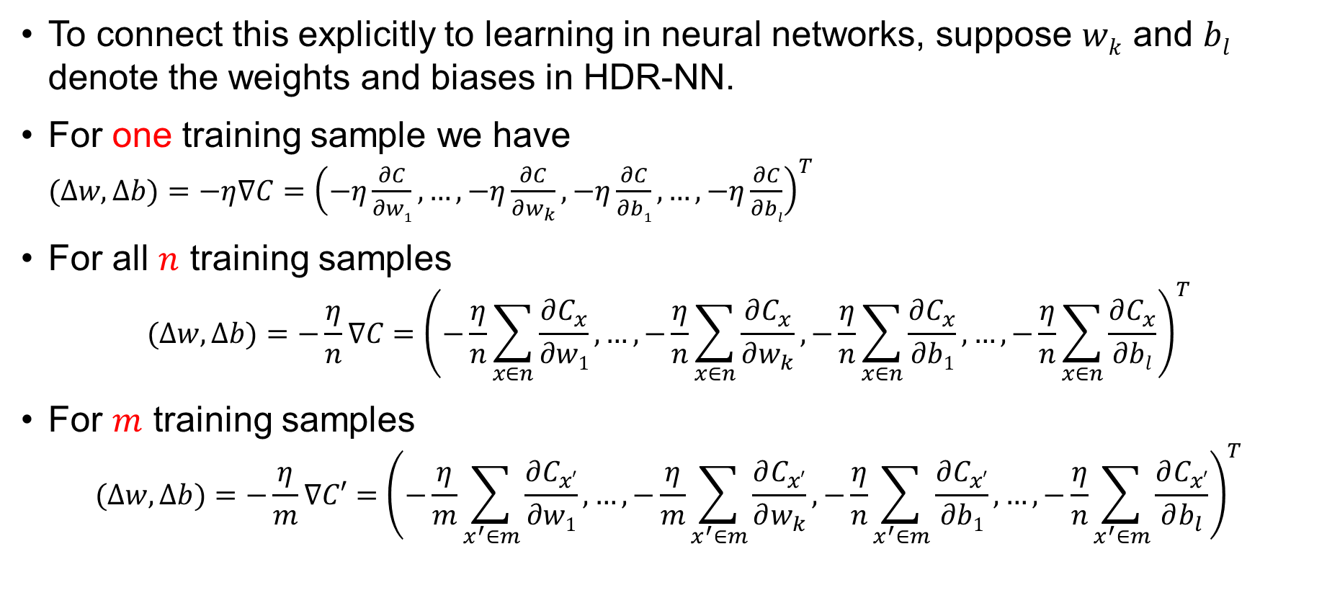
Applying SGD to HDR-NN
To connect this explicitly to learning in neural networks, suppose $wk$ and $bl$ denote the weights and biases in HDR-NN.
For one training sample we have $(∆w,∆b)=−η∇C={\left(−η\frac{∂C}{∂w1},…,−η\frac{∂C}{∂w_{k}},−η\frac{∂C}{∂b1},…,−η\frac{∂C}{∂bl}\right)}^{T}$
For all $n$ training samples $(∆w,∆b)=−\frac{η}{n}∇C={\left(−\frac{η}{n}\sum_{x∈n}{\frac{∂C_{x}}{∂w1}},…,−\frac{η}{n}\sum_{x∈n}{\frac{∂C_{x}}{∂w_{k}}},−\frac{η}{n}\sum_{x∈n}{\frac{∂C_{x}}{∂b1}},…,−\frac{η}{n}\sum_{x∈n}{\frac{∂C_{x}}{∂bl}}\right)}^{T}$
For $m$ training samples $(∆w,∆b)=−\frac{η}{m}∇C′={\left(−\frac{η}{m}\sum_{x^{′}∈m}{\frac{∂C_{x′}}{∂w1}},…,−\frac{η}{m}\sum_{x^{′}∈m}{\frac{∂C_{x′}}{∂w_{k}}},−\frac{η}{n}\sum_{x^{′}∈m}{\frac{∂C_{x′}}{∂b1}},…,−\frac{η}{n}\sum_{x^{′}∈m}{\frac{∂C_{x′}}{∂b_{l}}}\right)}^{T}$
Eq (1)
Eq (2)
Eq (3)

Slide 50
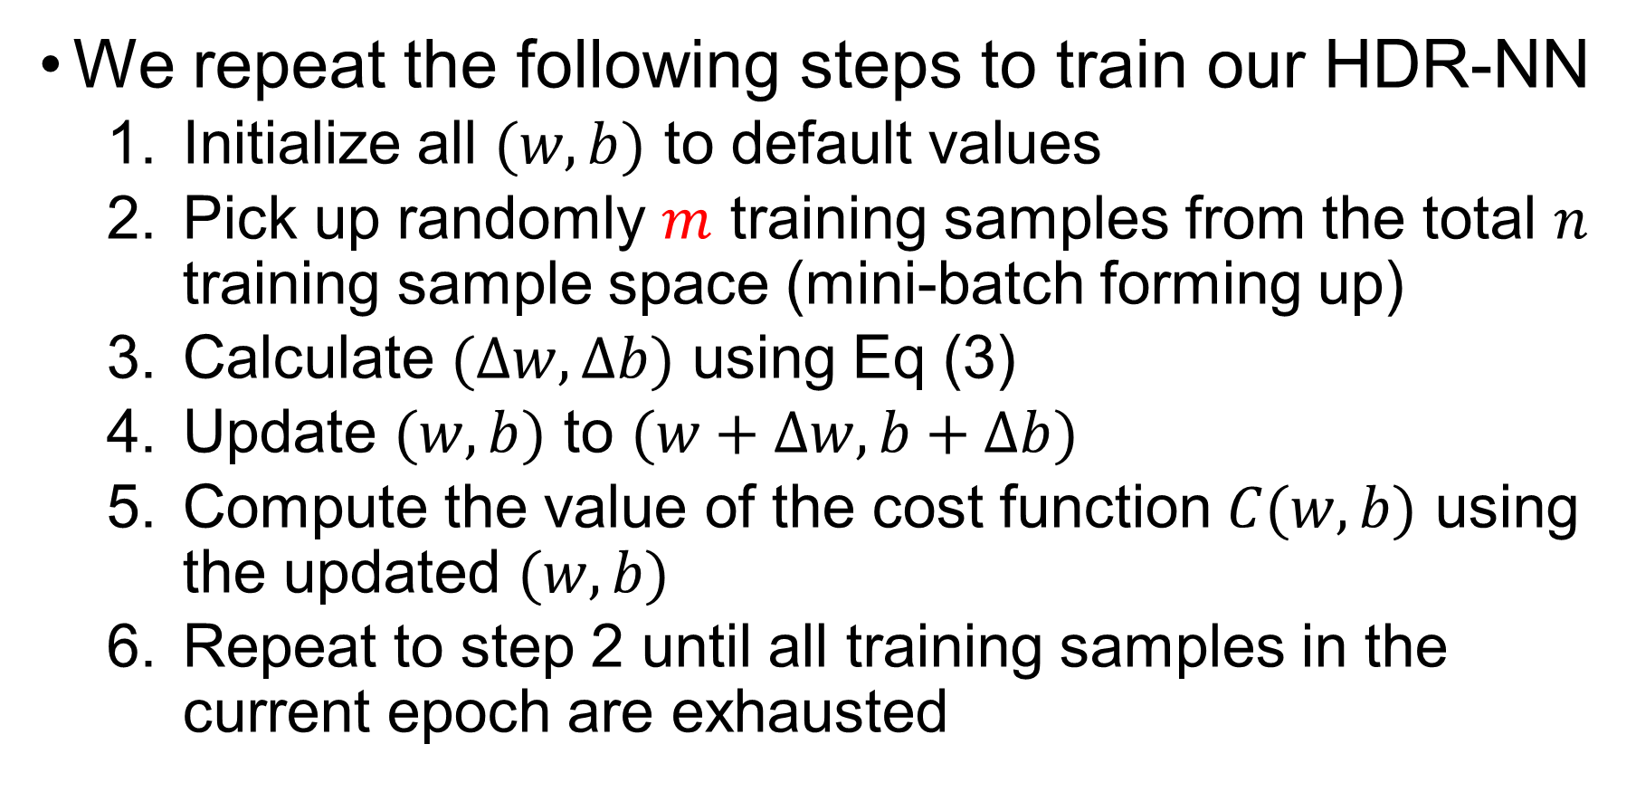
Applying SGD to HDR-NN
We repeat the following steps to train our HDR-NN
Initialize all $(w,b)$ to default values
Pick up randomly $m$ training samples from the total $n$ training sample space (mini-batch forming up)
Calculate $(∆w,∆b)$ using Eq (3)
Update $(w,b)$ to $(w+∆w,b+∆b)$
Compute the value of the cost function $C(w, b)$ using the updated $(w,b)$
Repeat to step 2 until all training samples in the current epoch are exhausted

Slide 51
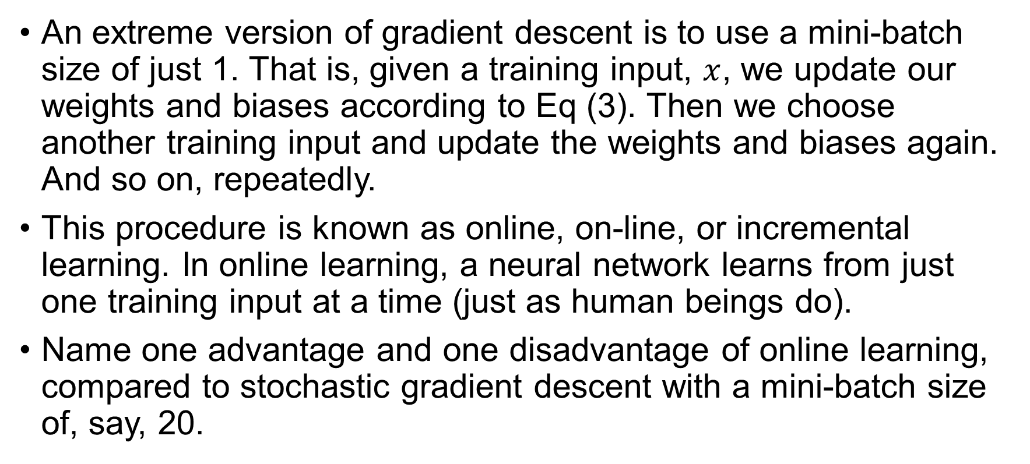
Exercise 4
An extreme version of gradient descent is to use a mini-batch size of just 1. That is, given a training input, $x$, we update our weights and biases according to Eq (3). Then we choose another training input and update the weights and biases again. And so on, repeatedly.
This procedure is known as online, on-line, or incremental learning. In online learning, a neural network learns from just one training input at a time (just as human beings do).
Name one advantage and one disadvantage of online learning, compared to stochastic gradient descent with a mini-batch size of, say, 20.

Slide 52

Questions?

